Slide 1




Slide 2
Watson Assistant Logging and Considerations
Overview of this deck
What are Assistant logs?
Using the logs method to obtain data.
What can be done with log data.

Slide 3
Logging
Watson assistant can log ALL data pertaining to its conversations. In general logs hold every utterance, the time stamp, the confidences, the node identifier, the response from Watson etc. etc.
Once logs are captured they can not be “un-logged”
If logging is “turned off” no logs will be available.
Logs are kept for 90 days on premium instances.
Requested logs get returned in a JSON object.
Exhaustive Logs Documentation: https://cloud.ibm.com/apidocs/assistant/assistant-v1#list-log-events-in-a-workspace
How to request logs
A complete listing of all data returned in Logs
How to filter logs
How to increase log request limit (Default 40/30min.)
What are Assistant logs?

Slide 4
Logging Contents
190+ data points for each turn in the dialog
Turn in the dialog= User input, WA response
Get’s returned as a JSON Object
Includes:
Conversation / Session Id
Dialog turn and node tracking
Input and output text
Identified Intents and Entities and associated confidence
Request & response timestamps (YYYY/MM/DD/HH/MM/SS)
Workspace ID
Integrated Interface Systems Designation
Context Variables
What is in Assistant logs?

Slide 5
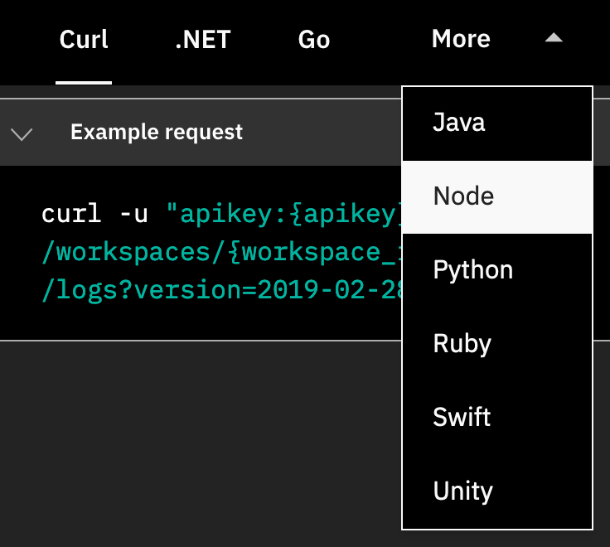
The logs method can be called in a variety of languages and will return logged data as a JSON object
Using the logs method
https://cloud.ibm.com/apidocs/assistant/assistant-v1#list-log-events-in-a-workspace

Slide 6
CURL Example: curl -u "apikey:Y9hdrgwBweTrcTb" "https://gateway.watsonplatform.net/assistant/api/v1/workspaces/4afafcf2cf8dx/logs?version=2018-09-20"
Postman Collection Template: https://www.getpostman.com/collections/0da8dd9140153e842dcb
Script for Pulling down logs and converting to CSV: https://github.ibm.com/pratyushsingh/Logs-Retrieval-Watson-Assistant Watson Studio Notebooks (can also be run on prem):
Measure: https://dataplatform.cloud.ibm.com/exchange/public/entry/view/133dfc4cd1480bbe4eaa78d3f635e568
Analyze: https://dataplatform.cloud.ibm.com/exchange/public/entry/view/133dfc4cd1480bbe4eaa78d3f636921c
IBM Continuous Improvements Best Practices: https://www.ibm.com/downloads/cas/V0XQ0ZRE
Using the logs method

